Slide 1
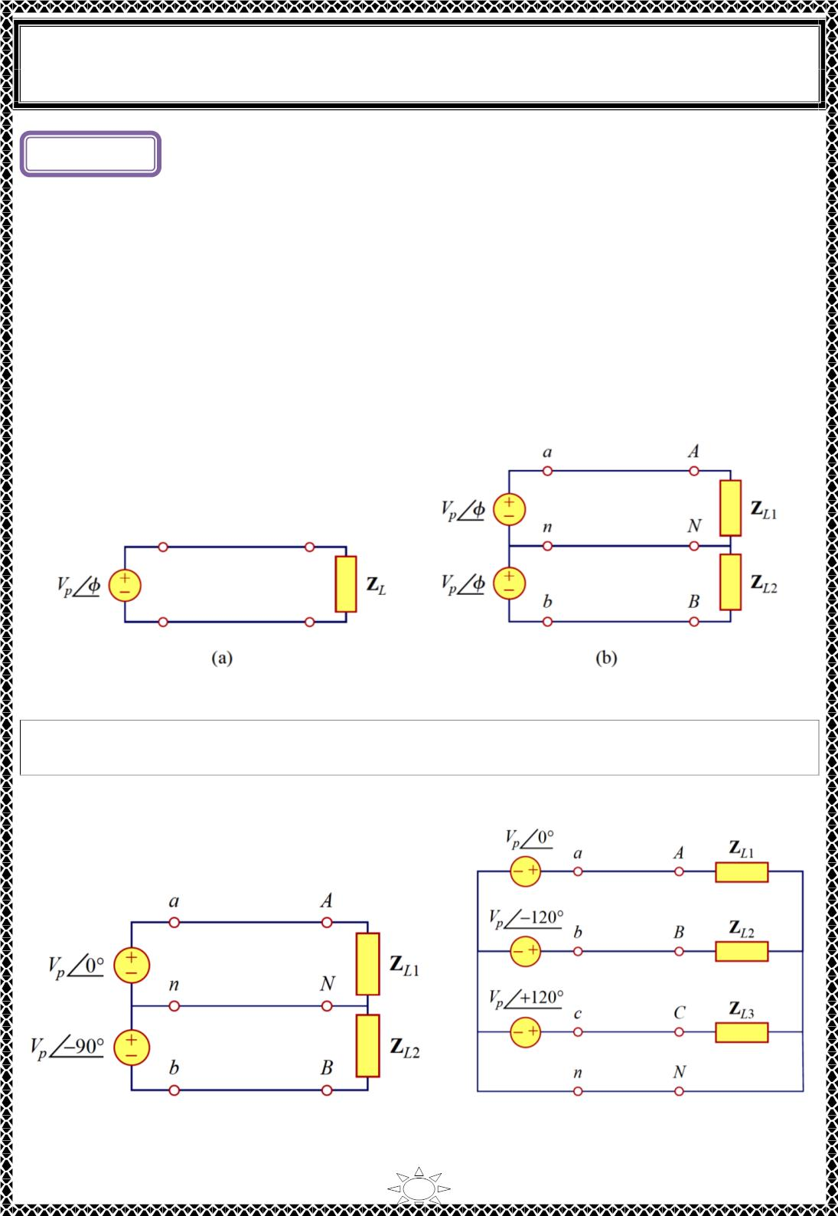
University of Diyala
Engineering College
Electronic Department
Electrical Circuits
2nd Class
Lecturer : Wisam N. AL-Obaidi
Year (2015-2016)
Lecture ( )
Three-Phase Circuits
1) Introduction
A single-phase ac power system consists of a generator connected through a pair of wires
(a transmission line) to a load. Fig.1.1 (a) depicts a single-phase twowire system, where Vp
is the rms magnitude of the source voltage and ϕ is the phase. What is more common in
practice is a single-phase threewire system, shown in Fig.1.1 (b). It contains two identical
sources (equal magnitude and the same phase) that are connected to two loads by two
outer wires and the neutral. For example, the normal household system is a single-phase
three-wire system because the terminal voltages have the same magnitude and the same
phase. Such a system allows the connection of both 120-V and 240-V appliances.
Trail Version
Trail Version
Trail Version
Trail Version
Trail Version
Trail Version
Trail Version
Trail Version
Trail Version
Trail Version
Trail Version
Trail Version
Trail Version
Fig.1.1 Single-phase systems: (a) two-wire type, (b) three-wire type.
Circuits or systems in which the ac sources operate at the same frequency but different
phases are known as polyphase.
Fig.1.2 shows a two-phase three-wire system, and Fig.1.3 shows a three-phase fourwire
system.
Fig.1.2 Two-phase three-wire system
Fig.1.3 Three-phase four-wire system
1

Slide 2
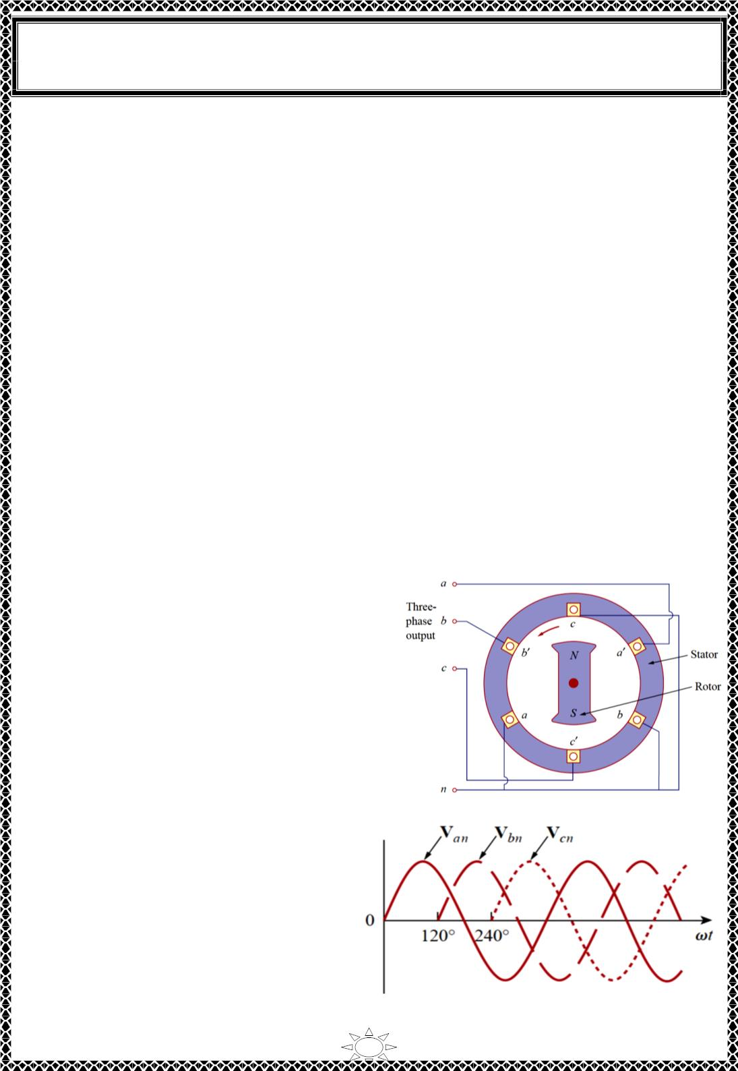
University of Diyala
Engineering College
Electronic Department
Electrical Circuits
2nd Class
Lecturer : Wisam N. AL-Obaidi
Year (2015-2016)
A single-phase system, a two-phase system is produced by a generator consisting of two coils
placed perpendicular to each other so that the voltage generated by one lags the other by 90⁰.
A three-phase system is produced by a generator consisting of three sources having the same
amplitude and frequency but out of phase with each other by 120⁰. Since the three-phase
system is by far the most prevalent and most economical polyphase system.
Three-phase systems are important for at least three reasons:
1) nearly all electric power is generated and distributed in three-phase, at the operating
frequency of 60 Hz (or ω =377 rad/s) or 50 Hz (or ω =314 rad/s). When one-phase or
two-phase inputs are required, they are taken from the three-phase system rather than
generated independently. Even when more than three phases are needed—such as in
the aluminum industry, where 48 phases are required for melting purposes—they can
be provided by manipulating the three phases supplied.
2) the instantaneous power in a three-phase system can be constant (not pulsating. This
results in uniform power transmission and less vibration of three-phase machines.
3) for the same amount of power, the three-phase system is more economical than the
singlephase. The amount of wire required for a three-phase system is less than that
required for an equivalent single-phase system.
Trail Version
Trail Version
Trail Version
Trail Version
Trail Version
Trail Version
Trail Version
Trail Version
Trail Version
Trail Version
Trail Version
Trail Version
Trail Version
2) Balanced Three-Phase Voltages
Three-phase voltages are often produced with a
three-phase ac generator (or alternator) whose
cross-sectional view is shown in Fig.2.1. The
generator basically consists of a rotating magnet
(called the rotor) surrounded by a stationary
winding (called the stator). Three separate
windings or coils with terminals a-a', b-b',and c-
c' are physically placed 120⁰ apart around the
stator. As the rotor rotates, its magnetic field
“cuts” the flux from the three coils and induces
voltages in the coils.
Fig.2.1 A three-phase generator
Because the coils are placed 120⁰ apart, the
induced voltages in the coils are equal in
magnitude but out of phase by 120⁰
(Fig.2.2). Since each coil can be regarded
as a single-phase generator by itself, the
three-phase generator can supply power to
both single-phase and three-phase loads.
Fig.2.2 Generated voltages 120⁰ apart from each other
2

Slide 3
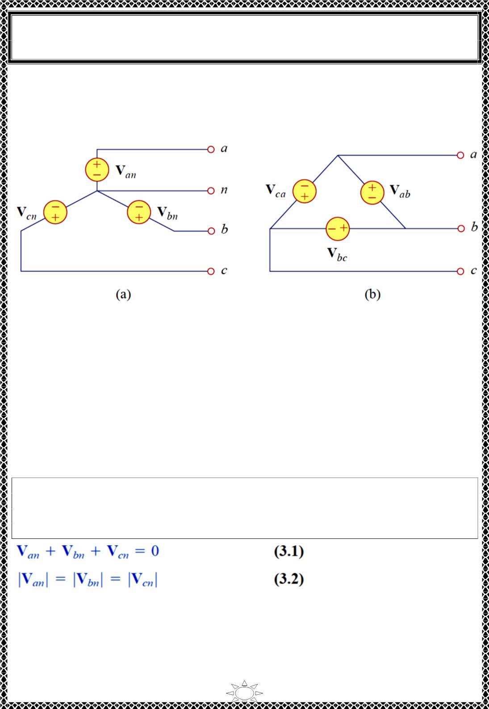
University of Diyala
Engineering College
Electronic Department
Electrical Circuits
2nd Class
Lecturer : Wisam N. AL-Obaidi
Year (2015-2016)
A typical three-phase system consists of three voltage sources connected to loads by three
or four wires (or transmission lines). (Threephase current sources are very scarce.) A
three-phase system is equivalent to three single-phase circuits. The voltage sources can be
either wye-connected as shown in Fig.2.3(a) or delta-connected as in Fig.2.3(b).
Fig.2.3 Three-phase voltage sources: (a) Y-connected source, (b) –connected source.
Trail Version
Trail Version
Trail Version
Trail Version
Trail Version
Trail Version
Trail Version
Trail Version
Trail Version
Trail Version
Trail Version
Trail Version
Trail Version
3)Phase sequences
Consider the wye-connected voltages in Fig. Fig.2.3 (a). The voltages V , V and V are
called phase voltages.
Where
Van : is the voltage between line a and the neutral line n.
Vbn : is the voltage between line b and the neutral line n.
Vcn : is the voltage between line c and the neutral line n.
an
bn
cn
If the voltage sources have the same amplitude and frequency ω and are out of phase with
each other by 120⁰ the voltages are said to be balanced. Thus , Balanced phase voltages
are equal in magnitude and are out of phase with each other by 120⁰.
This implies that,
3

Slide 4
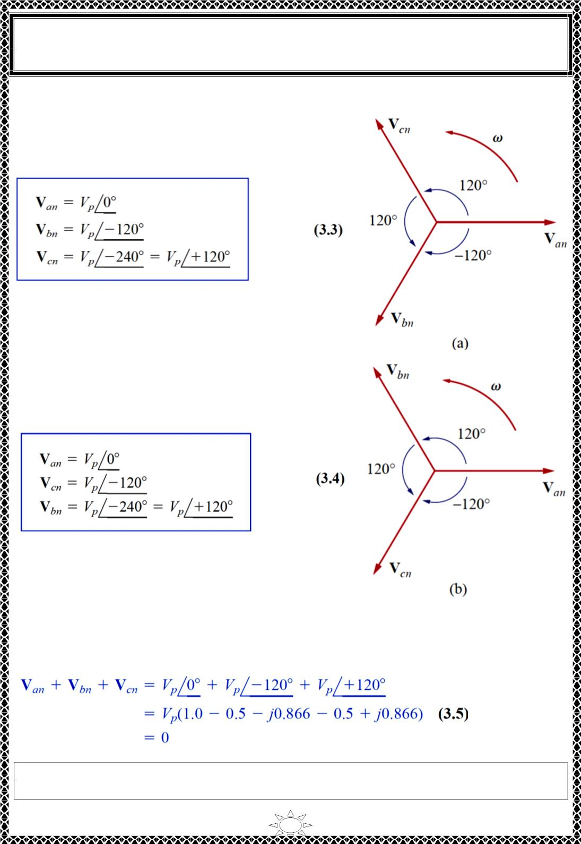
University of Diyala
Engineering College
Electronic Department
Electrical Circuits
2nd Class
Lecturer : Wisam N. AL-Obaidi
Year (2015-2016)
Since the three-phase voltages are 120⁰ out of phase with each other, there are two
possible combinations. One is shown in Fig.3.1(a) and
known as the abc sequence or positive sequence. This
sequence is produced when the rotor in Fig.2.1 rotates
counterclockwise direction.
where Vp is the effective or rms value of the phase
voltages.
The other is shown in Fig.3.1(b) and known as the acb
sequence or negative sequence. This sequence is produced
when the rotor in Fig.2.1 rotates clockwise direction.
Trail Version
Trail Version
Trail Version
Trail Version
Trail Version
Trail Version
Trail Version
Trail Version
Trail Version
Trail Version
Trail Version
Trail Version
Trail Version
Fig.3.1Phase sequences: (a) abc or positive
sequence, (b) acb or negative sequence.
The phase sequence is the time order in which the voltages pass through their
respective maximum values.
4

Slide 5
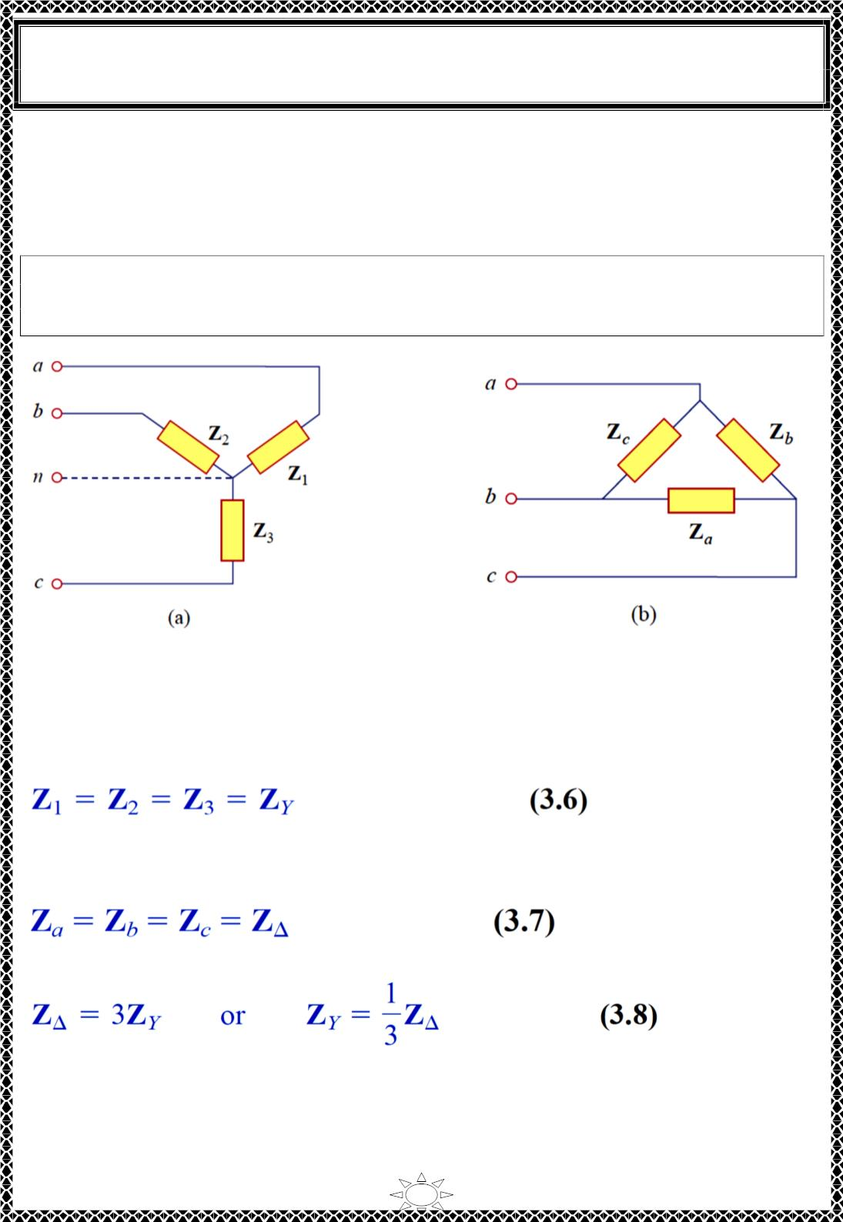
University of Diyala
Engineering College
Electronic Department
Electrical Circuits
2nd Class
Lecturer : Wisam N. AL-Obaidi
Year (2015-2016)
Like the generator connections, a three-phase load can be either wye-connected or delta-
connected, depending on the end application. Fig.3.2(a) shows a wye-connected load, and
Fig.3.2(b) shows a delta-connected load. The neutral line in Fig.3.2(a) may or may not be
there, depending on whether the system is four- or three-wire. (And, of course, a neutral
connection is topologically impossible for a delta connection.)
A wye- or delta-connected load is said to be unbalanced if the phase impedances are not
equal in magnitude or phase. So A balanced load is one in which the phase
impedances are equal in magnitude and in phase.
Trail Version
Trail Version
Trail Version
Trail Version
Trail Version
Trail Version
Trail Version
Trail Version
Trail Version
Trail Version
Trail Version
Trail Version
Trail Version
Fig.3.2 Two possible three-phase load configurations:
(a) a Y-connected load, (b) a ∆-connected load.
For a balanced wye-connected load,
where ZY is the load impedance per phase.
For a balanced delta-connected load,
where 풁∆ is the load impedance per phase.
so we know that a wye-connected load can be transformed into a deltaconnected load, or
vice versa, using Eq. (3.8). so we know that a wye-connected load can be transformed into
a deltaconnected load, or vice versa, using Eq. (3.8).
5

Slide 6
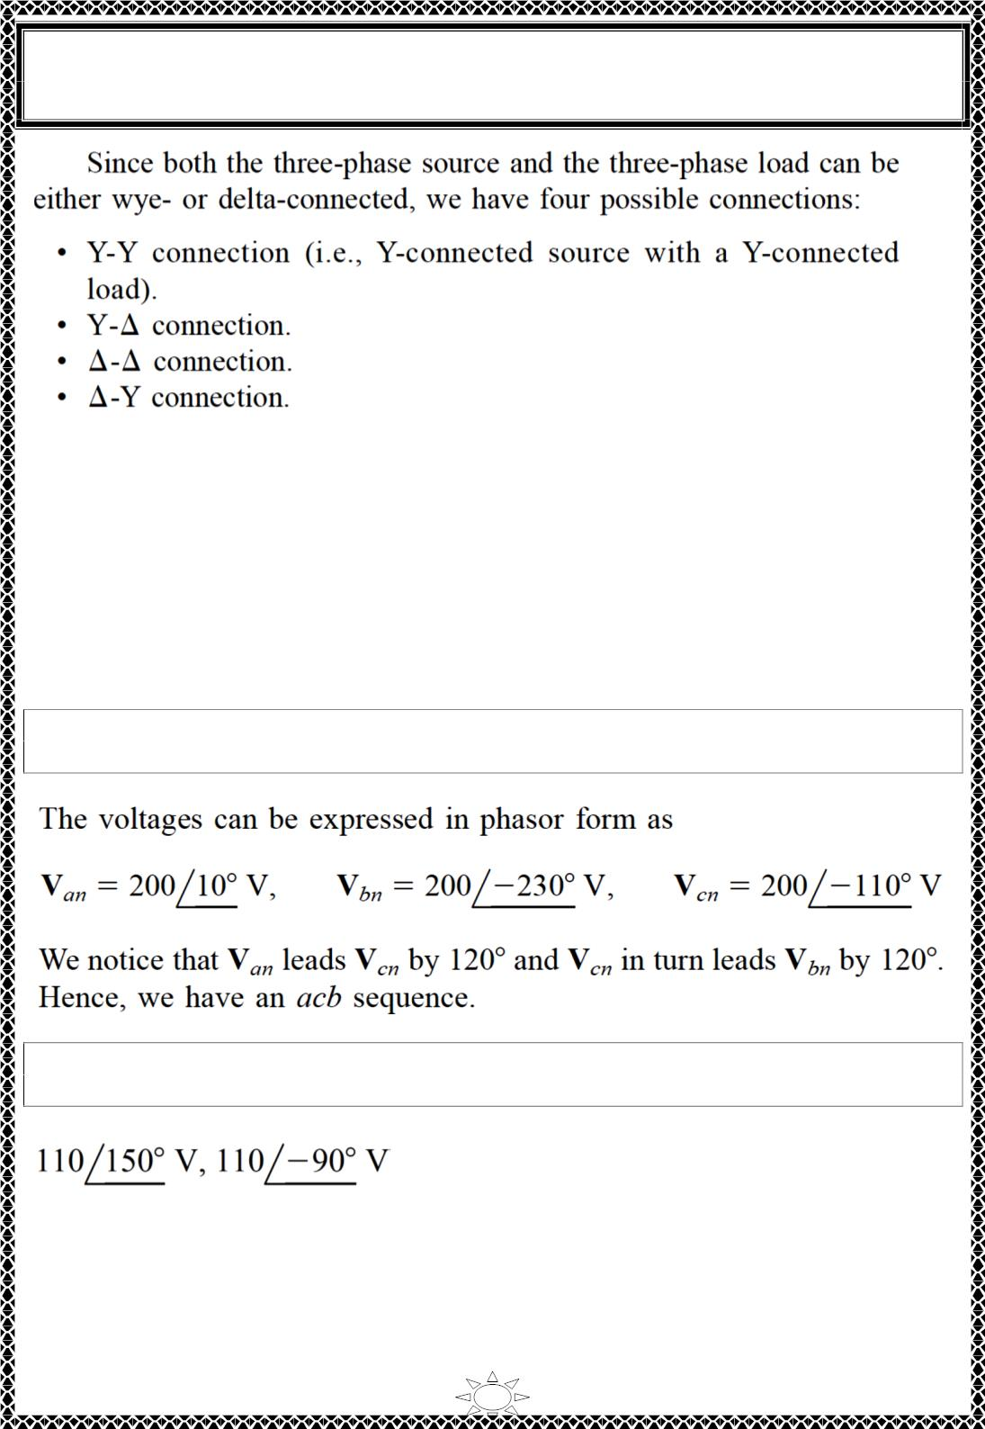
University of Diyala
Engineering College
Electronic Department
Electrical Circuits
2nd Class
Lecturer : Wisam N. AL-Obaidi
Year (2015-2016)
It is appropriate to mention here that a balanced delta-connected load is more common
than a balanced wye-connected load. This is due to the ease with which loads may be
added or removed from each phase of a delta-connected load. This is very difficult with a
wye-connected load because the neutral may not be accessible. On the other hand, delta-
connected sources are not common in practice because of the circulating current that will
result in the delta-mesh if the three-phase voltages are slightly unbalanced.
Trail Version
Trail Version
Trail Version
Trail Version
Trail Version
Trail Version
Trail Version
Trail Version
Trail Version
Trail Version
Trail Version
Trail Version
Trail Version
Example 1: Determine the phase sequence of the set of voltages
푣_{푎푛} = 200 cos(휔푡 + 10ꢀ) , 푣_{푏푛} = 200 cos(휔푡 − 230ꢀ) , 푣_{푐푛} = 200 cos(휔푡 − 110ꢀ)
Solution:
H.W.1: Given that 푣_{푏푛} = 110∠30^{ꢀ 푉,} find
sequence.
푣
^{and 푣}푐푛 assuming a possitive (abc)
푎푛
Answer:
6

Slide 7
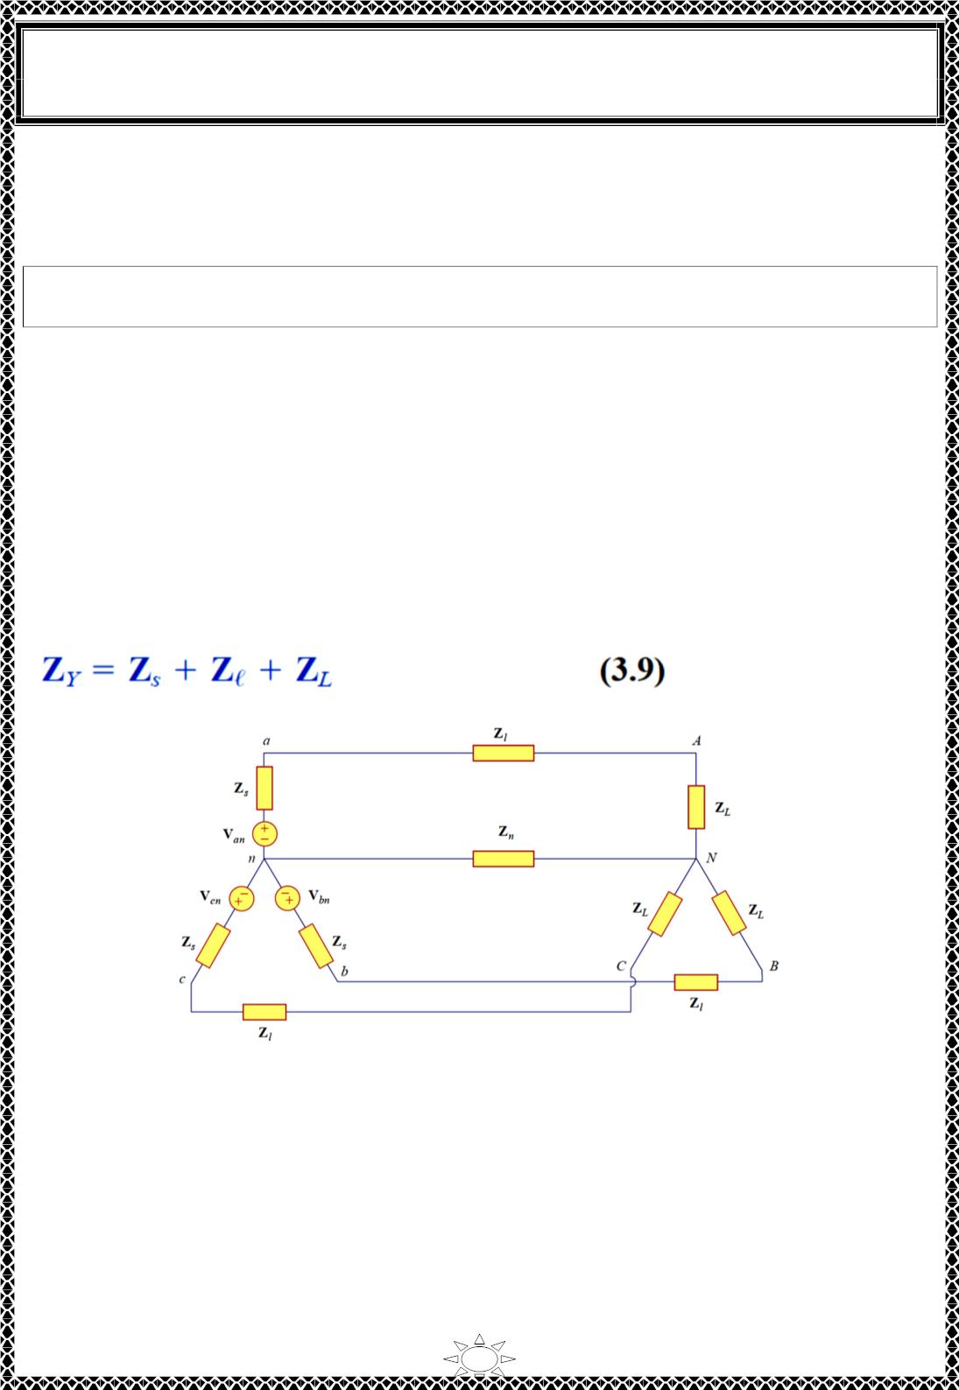
University of Diyala
Engineering College
Electronic Department
Electrical Circuits
2nd Class
Lecturer : Wisam N. AL-Obaidi
Year (2015-2016)
3.1) Balanced Wye-Wye Connection
We begin with the Y-Y system, because any balanced three-phase system can be reduced
to an equivalent Y-Y system. Therefore, analysis of this system should be regarded as the
key to solving all balanced three-phase systems.
A balanced Y-Y system is a three-phase system with a balanced Y-connected
source and a balanced Y-connected load.
Consider the balanced four-wire Y-Y system of Fig.3.3, where a Y-connected load is
connected to a Y-connected source. We assume a balanced load so that load impedances
are equal.
Where
ZY: is the total load impedance per phase
Zs: is the source impedance (or the internal impedance of the phase winding of the
generator)
풁_{퓵}: is the line impedance
ZL: is the load impedance per phase
Zn: is the impedance of the neutral line
since these impedances are in series. As illustrated in Fig.3.3, thus
Trail Version
Trail Version
Trail Version
Trail Version
Trail Version
Trail Version
Trail Version
Trail Version
Trail Version
Trail Version
Trail Version
Trail Version
Trail Version
Fig.3.3 A balanced Y-Y system, showing the source, line, and load impedances.
NOTE: Z and 풁 are often very small compared with Z , so one can assume that Z = Z
L
s
퓵
L
Y
(neglecting Z and 풁 ) if no source or line impedance is given. So Fig.3.3 can be
s
퓵
simplified as in Fig.3.4 .
7

Slide 8
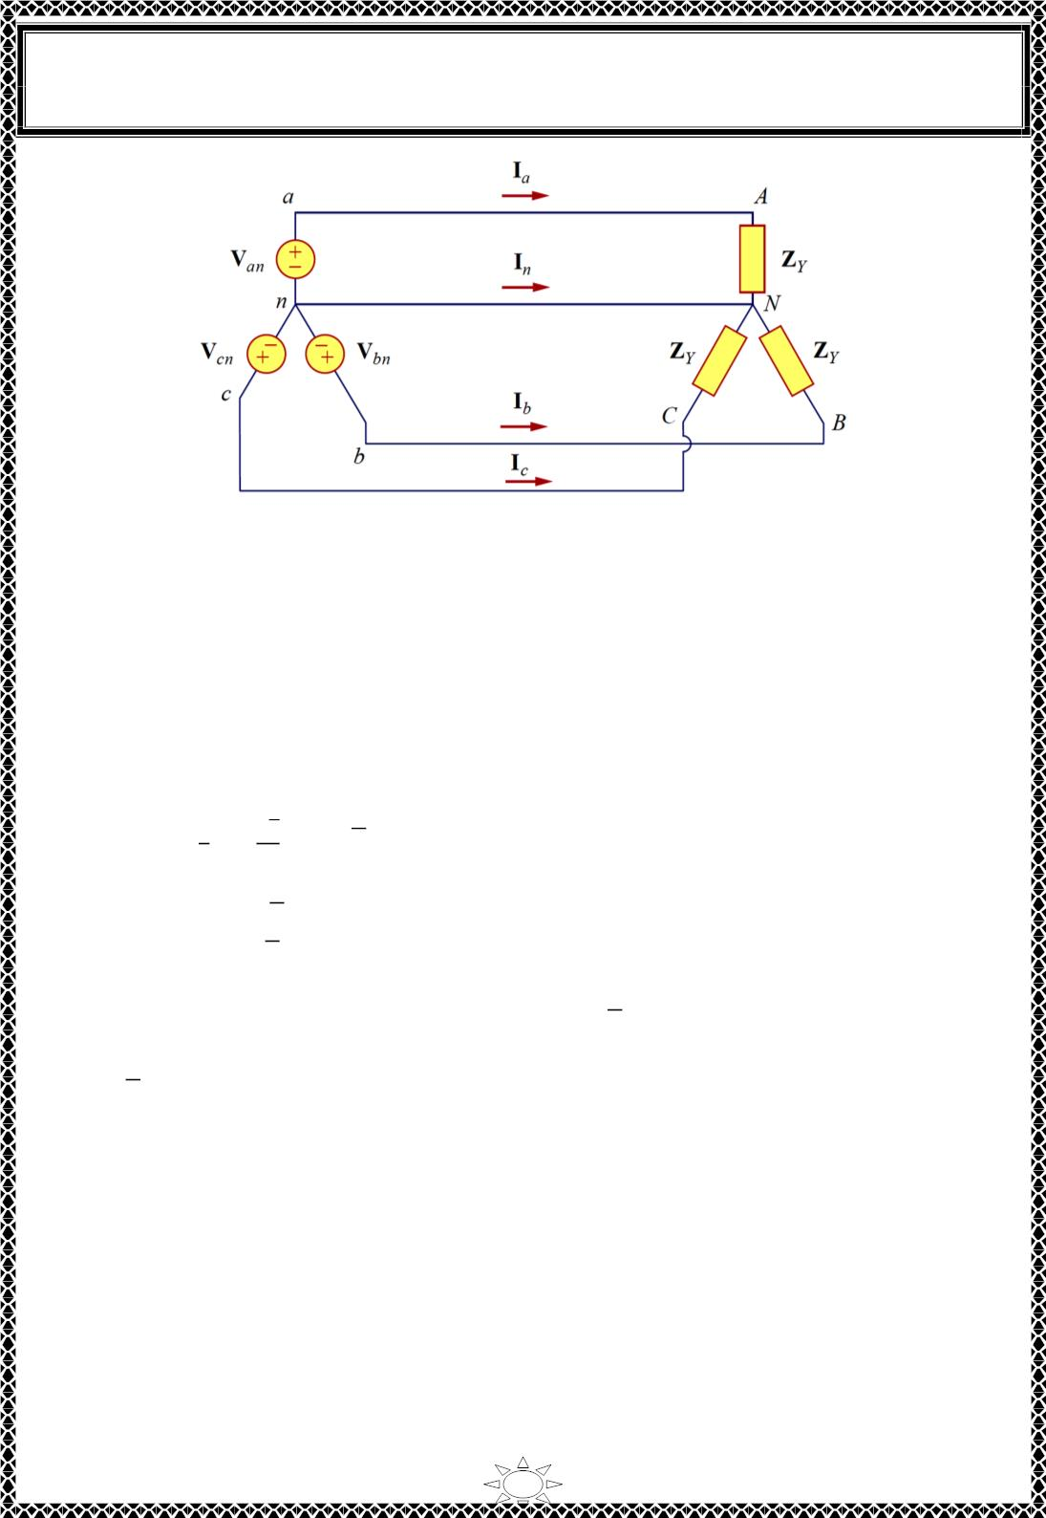
University of Diyala
Engineering College
Electronic Department
Electrical Circuits
2nd Class
Lecturer : Wisam N. AL-Obaidi
Year (2015-2016)
Fig.3.4 A balanced Y-Y connection.
For positive sequence, the phase voltages (or line-toneutral voltages) are
푉 = 푉 ∠0ꢀ
푎푛
푝
푉
푏푛
= 푉_{푝}∠−120ꢀ}
(ퟑ. ퟏퟎ)
푉 = 푉 ∠+120ꢀ
Trail Version
Trail Version
Trail Version
Trail Version
Trail Version
Trail Version
Trail Version
Trail Version
Trail Version
Trail Version
Trail Version
Trail Version
푐푛
푝
Trail Version
The line-to-line voltages or simply line voltages V , V , and V are related to the phase
voltages. For example
ab
bc
ca
푉
푎푏
= 푉_{푎푛} + 푉 = 푉_{푎푛} − 푉 = 푉 ∠0ꢀ − 푉 ∠−120ꢀ
푛푏
ꢂ
√3
푏푛
푝
푝
= 푉 ꢁ1 + + 푗 ꢄ = √ꢅ 푉 ∠ꢅ0ꢀ
(3.11a)
푝
ꢃ
ꢃ
푝
Similarly,
푉 = 푉 − 푉 = √ꢅ 푉 ∠ − 90ꢀ
푏푐
푏푛
푐푛
푝
(3.11b)
(3.11c)
푉 = 푉 − 푉 = √ꢅ 푉 ∠ − 210ꢀ
푐푎
푐푛
푎푛
푝
Thus, the magnitude of the line voltages 푉 is √ꢅ times the magnitude of the phase
voltages 푉_{푝} or
퐿
푉_{퐿} = √ꢅ 푉
(3.12)
푝
Where
푉 = |푉 | = |푉 | = |푉 |
(3.13)
(3.14)
푝
푎푛
푏푛
푐푛
푉 = |푉 | = |푉 | = |푉 |
퐿
푎푏
푏푐
푐푎
Also the line voltages lead their corresponding phase voltages by 30⁰ as illustrated in
Fig.3.5 (a) which also shows how to determine 푉 from the phase voltages, while Fig.3.5
푎푏
(b) shows the same for the three line voltages. Notice that 푉 leads 푉 by 120⁰ and leads
푎푏
푏푐
푉 by 120⁰ so that the line voltages sum up to zero as do the phase voltages.
푐푎
8

Slide 9
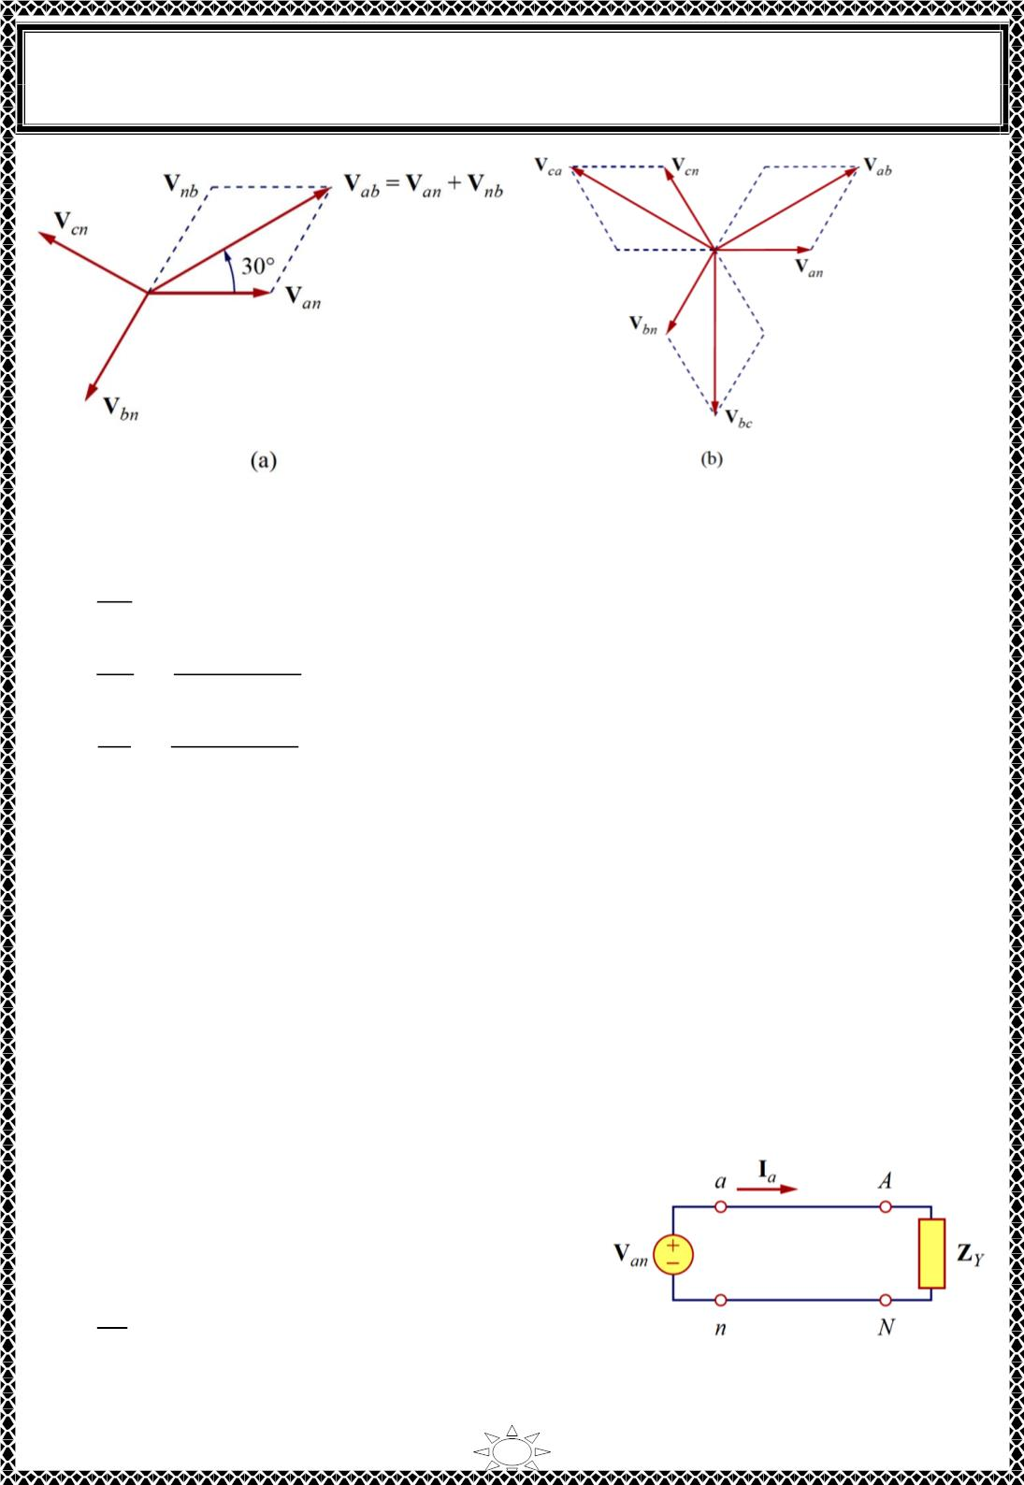
University of Diyala
Engineering College
Electronic Department
Electrical Circuits
2nd Class
Lecturer : Wisam N. AL-Obaidi
Year (2015-2016)
Fig.3.5 Phasor diagrams showing the relationship between line voltages & phase voltages.
Applying KVL to each phase in Fig.3.4, we obtain the line currents as
푉
퐼_{푎} =
퐼_{푏} =
퐼_{푐} =
푎푛
ꢃ
푍_{푌}
푉
푏푛
^{푍}푌
푉
푐푛
ꢁ
=
=
푉_{푎푛}∠−120ꢀ
= 퐼_{푎}∠−120ꢀ_{ꢂ}
(ퟑ. ퟏퟓ)
Trail Version
Trail Version
Trail Version
Trail Version
Trail Version
Trail Version
Trail Version
Trail Version
Trail Version
Trail Version
Trail Version
Trail Version
Trail Version
^{푍}푌
푉_{푎푛}∠−240ꢀ
ꢁ
}
푍
푍_{푌}
= 퐼_{푎}∠−240ꢀ
푌
퐼 + 퐼 + 퐼 = 0
(ퟑ. ퟏퟔ)
(ퟑ. ퟏퟕ풂)
(ퟑ. ퟏퟕ풃)
푎
푏
푐
퐼 = −(퐼 + 퐼 + 퐼 ) = 0
푛
푎
푏
푐
푉
= 푍 퐼 = 0
푛 푛
푛푁
that is, the voltage across the neutral wire is zero. The neutral line can thus be removed
without affecting the system. In fact, in long distance power transmission, conductors in
multiples of three are used with the earth itself acting as the neutral conductor. Power
systems designed in this way are well grounded at all critical points to ensure safety.
While the line current is the current in each line, the phase current is the current in each
phase of the source or load. In the Y-Y system, the line current is the same as the phase current.
An alternative way of analyzing a balanced Y-Y
system is to do so on a “per phase” basis. We look
at one phase, say phase a, and analyze the single-
phase equivalent circuit in Fig.3.6. The single-phase
analysis yields the line current Ia as
ꢄ
퐼_{푎} = ꢅꢆ
ꢇ_{ꢈ}
(ퟑ. ퟏퟖ)
Fig.3.6 A single-phase equivalent circuit
9

Slide 10
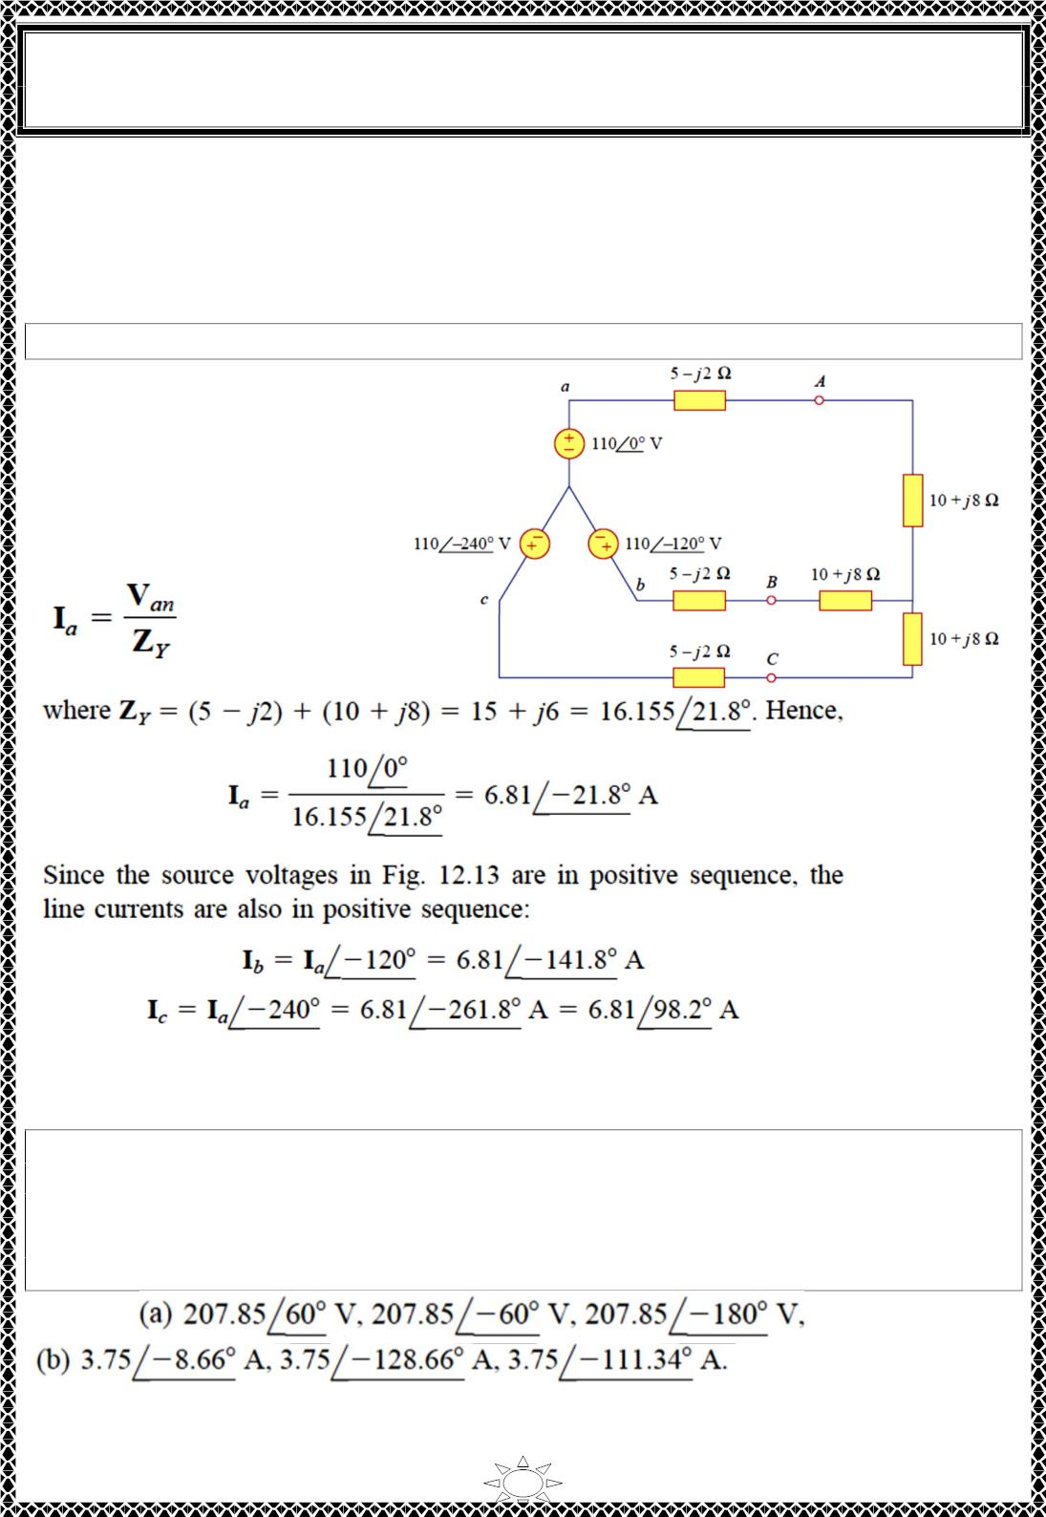
University of Diyala
Engineering College
Electronic Department
Electrical Circuits
2nd Class
Lecturer : Wisam N. AL-Obaidi
Year (2015-2016)
From Ia we use the phase sequence to obtain other line currents. Thus, as long as the
system is balanced, we need only analyze one phase. We may do this even if the neutral
line is absent, as in the three-wire system.
Example 2: Calculate the line currents in the three-wire Y-Y system of Fig.
Solution:
The three-phase circuit in Fig.
shown is balanced; we may
replace it with its single-phase
equivalent circuit such as in
Fig.3.6. We obtain Ia from the
single-phase analysis as
Trail Version
Trail Version
Trail Version
Trail Version
Trail Version
Trail Version
Trail Version
Trail Version
Trail Version
Trail Version
Trail Version
Trail Version
Trail Version
H.W.2: A Y-connected balanced three-phase generator with an impedance of 0.4+j0.3Ω
per phase is connected to a Y-connected balanced load with an impedance of 24+j19Ω per
phase. The line joining the generator and the load has an impedance of 0.6+j0.7Ω per
푽
phase. Assuming a positive sequence for the source voltages and that 푽_{풂풏} = ퟏퟐퟎ∠ퟑퟎ^{ퟎ}
find: (a) the line voltages, (b) the line currents
Answer:
10

